Slide 1


Slide 2


Slide 3

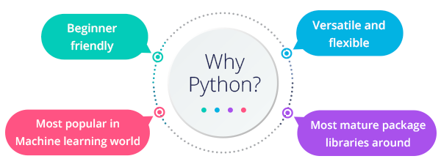
python

Slide 4
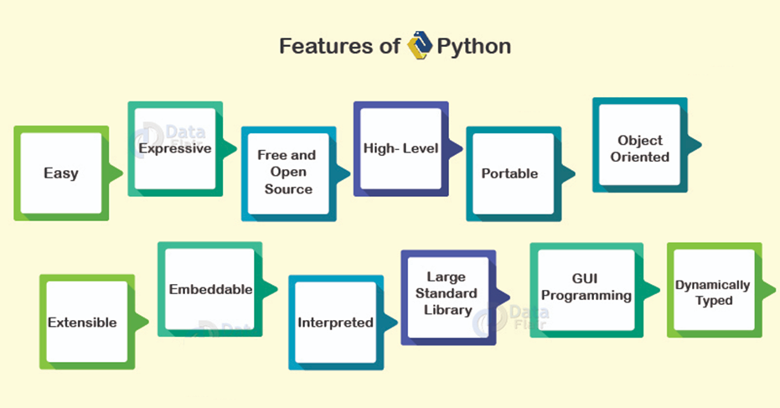
python

Slide 5

python

Slide 6
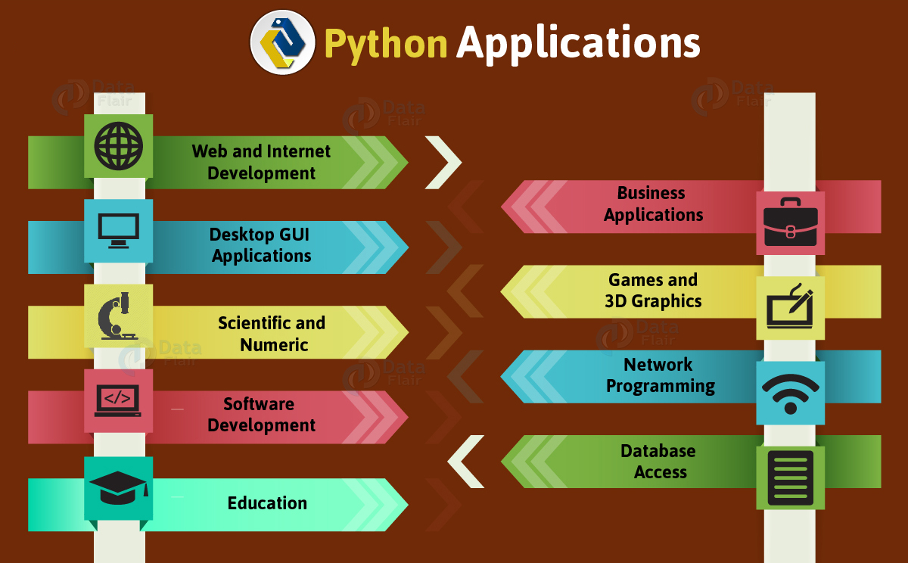

Slide 7
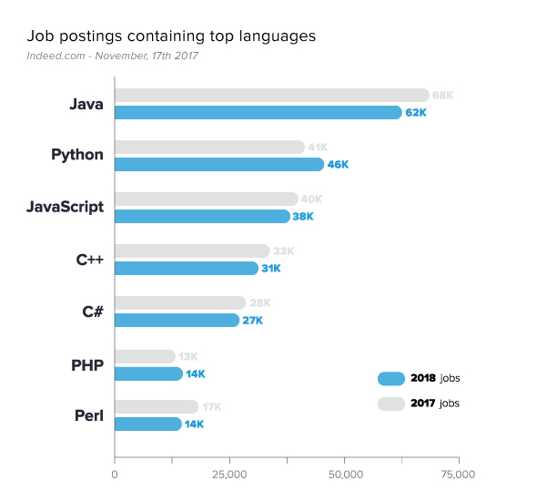
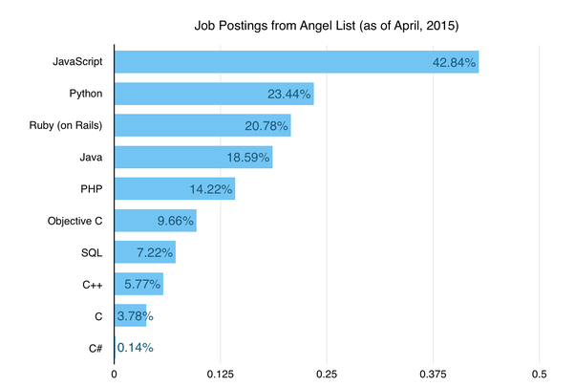
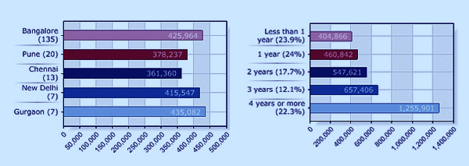
python salary

Slide 8


Slide 9
python
Simple
Python is a simple and minimalistic language in nature
Reading a good python program should be like reading English
Its Pseudo-code nature allows one to concentrate on the problem rather than the language
Easy to Learn
Free & Open source
Freely distributed and Open source
Maintained by the Python community
High Level Language –memory management
Portable – *runs on anything c code will

Slide 10
python
Interpreted
You run the program straight from the source code.
Python program →Bytecode →a platforms native language
You can just copy over your code to another system and it will auto-magically work! *with python platform
Object-Oriented
Simple and additionally supports procedural programming
Extensible – easily import other code
Embeddable –easily place your code in non-python programs
Extensive libraries

Slide 11
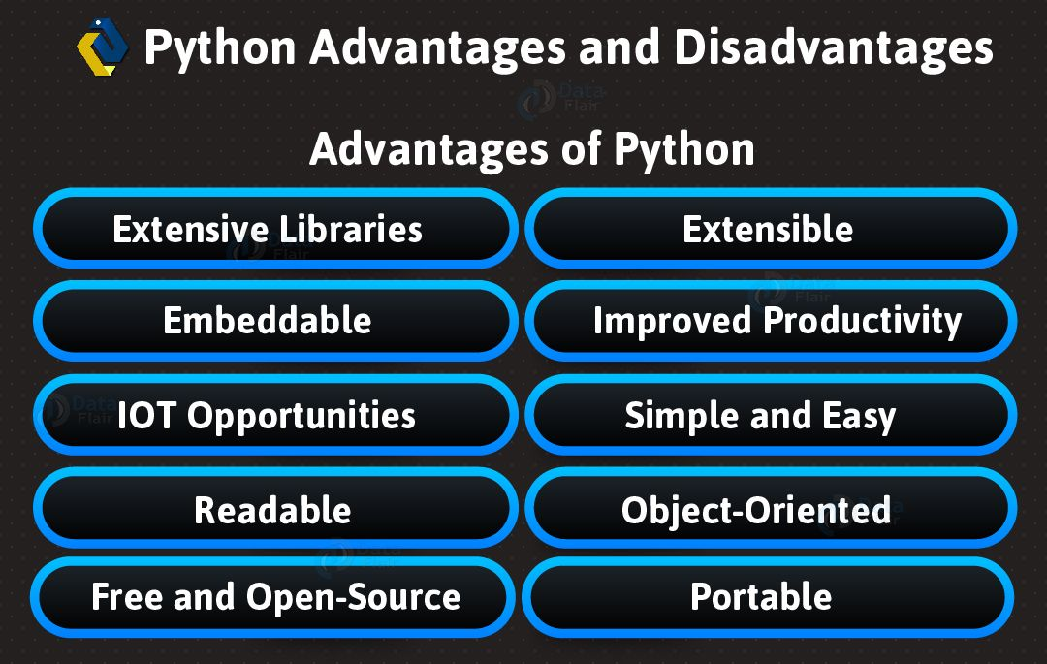

Slide 12
Variable types
Example types.py: pi = 3.1415926 message = "Hello, world" i = 2+2 print type(pi) print type(message) print type(i) Output: <type 'float'> <type 'str'> <type 'int'>

Slide 13
Variable names
Can contain letters, numbers, and underscores
Must begin with a letter or underscore
Cannot be one of the reserved Python keywords: and, as, assert, break, class, continue, def, del, elif, else, except, exec, finally, for, from, global, if, import, in, is, lambda, not, or, pass, print, raise, return, try, while, with, yield

Slide 14
More on variable names
Names starting with one underscore (_V) are not imported from the module import * statement
Names starting and ending with 2 underscores are special, system-defined names (e.g., __V__)‏
Names beginning with 2 underscores (but without trailing underscores) are local to a class (__V)‏
A single underscore (_) by itself denotes the result of the last expression

Slide 15
More on variable names
Names starting with one underscore (_V) are not imported from the module import * statement
Names starting and ending with 2 underscores are special, system-defined names (e.g., __V__)‏
Names beginning with 2 underscores (but without trailing underscores) are local to a class (__V)‏
A single underscore (_) by itself denotes the result of the last expression

Slide 16
Operators
+ addition
- subtraction
/ division
** exponentiation
% modulus (remainder after division)‏
Comparison operators in Chapter 2

Slide 17
Operators
Example operators.py print 2*2 print 2**3 print 10%3 print 1.0/2.0 print 1/2 Output: 4 8 1 0.5 0
Note the difference between floating point division and integer division in the last two lines

Slide 18
+= but not ++
Python has incorporated operators like +=, but ++ (or --) do not work in Python

Slide 19
String Methods: find, split
smiles = "C(=N)(N)N.C(=O)(O)O"
>>> smiles.find("(O)")
15
>>> smiles.find(".")
9
>>> smiles.find(".", 10)
-1
>>> smiles.split(".")
['C(=N)(N)N', 'C(=O)(O)O']
>>>
Use “find” to find the
start of a substring.
Start looking at position 10.
Find returns -1 if it couldn’t
find a match.
Split the string into parts
with “.” as the delimiter

Slide 20
String operators: in, not in
if "Br" in “Brother”:
print "contains brother“
email_address = “clin”
if "@" not in email_address:
email_address += "@brandeis.edu“

Slide 21
String Method: “strip”, “rstrip”, “lstrip” are ways to remove whitespace or selected characters
>>> line = " # This is a comment line \n"
>>> line.strip()
'# This is a comment line'
>>> line.rstrip()
' # This is a comment line'
>>> line.rstrip("\n")
' # This is a comment line '
>>>

Slide 22
More String methods
email.startswith(“c") endswith(“u”)
True/False
>>> "%s@brandeis.edu" % "clin"
'clin@brandeis.edu'
>>> names = [“Ben", “Chen", “Yaqin"]
>>> ", ".join(names)
‘Ben, Chen, Yaqin‘
>>> “chen".upper()
‘CHEN'

Slide 23
Unexpected things about strings
Strings are read only
>>> s = "andrew"
>>> s[0] = "A"
Traceback (most recent call last):
File "<stdin>", line 1, in <module>
TypeError: 'str' object does not support item assignment
>>> s = "A" + s[1:]
>>> s
'Andrew‘

Slide 24
“\” is for special characters
\n -> newline
\t -> tab
\\ -> backslash
...
But Windows uses backslash for directories!
filename = "M:\nickel_project\reactive.smi" # DANGER!
filename = "M:\\nickel_project\\reactive.smi" # Better!
filename = "M:/nickel_project/reactive.smi" # Usually works

Slide 25
Type conversion
int(), float(), str(), and bool() convert to integer, floating point, string, and boolean (True or False) types, respectively
Example typeconv.py: print 1.0/2.0 print 1/2 print float(1)/float(2) print int(3.1415926) print str(3.1415926) print bool(1) print bool(0)‏
Output: 0.5 0 0.5 3 3.1415926 True False

Slide 26
Operators acting on strings
>>> "Ni!"*3 'Ni!Ni!Ni!'
>>> "hello " + "world!" 'hello world!'

Slide 27
Input from keyboard
Example input.py i = raw_input("Enter a math expression: ") print i j = input("Enter the same expression: ") print j Output: localhost(workshop)% ./input.py Enter a mathematical expression: 3+2 3+2 Enter the same expression: 3+2 5

Slide 28
Comments
Anything after a # symbol is treated as a comment
This is just like Perl

Slide 29
Conditionals
True and False booleans
Comparison and Logical Operators
if, elif, and else statements

Slide 30
Booleans: True and False
>>> type (True) <type 'bool'> >>> type (true) Traceback (most recent call last): File "<stdin>", line 1, in <module> NameError: name 'true' is not defined >>> 2+2==5 False
Note: True and False are of type bool. The capitalization is required for the booleans!

Slide 31
Boolean expressions
A boolean expression can be evaluated as True or False. An expression evaluates to False if it is... the constant False, the object None, an empty sequence or collection, or a numerical item of value 0
Everything else is considered True

Slide 32
Comparison operators
== : is equal to?
!= : not equal to
> : greater than
< : less than
>= : greater than or equal to
<= : less than or equal to
is : do two references refer to the same object? (See Chapter 6)‏

Slide 33
More on comparisons
Can “chain” comparisons: >>> a = 42 >>> 0 <= a <= 99 True

Slide 34
Logical operators
and, or, not >>> 2+2==5 or 1+1==2 True >>> 2+2==5 and 1+1==2 False >>> not(2+2==5) and 1+1==2 True
Note: We do NOT use &&, ||, !, as in C!

Slide 35
If statements
Example ifelse.py if (1+1==2): print "1+1==2" print "I always thought so!" else: print "My understanding of math must be faulty!"
Simple one-line if: if (1+1==2): print “I can add!”

Slide 36
elif statement
Equivalent of “else if” in C
Example elif.py: x = 3 if (x == 1): print "one" elif (x == 2): print "two" else: print "many"

